Slide 1

50.039 Theory and Practice of Deep Learning W5-S3 Times Series Data and Recurrent Neural Networks
Matthieu De Mari

Slide 2
About this week (Week 5)
What is a time series dataset?
How to analyze a time series, and what are typical deep learning models capable of doing that?
What is history, and why is it needed for time series predictions?
What is a good history length?
What is memory and how to represent it in a Neural Network model?
How to implement a first vanilla Recurrent Neural Network model?
Why is the vanishing gradient problem prominent in RNNs?

Slide 3
About this week (Week 5)
What is the LSTM model?
What is the GRU model?
What are one-to-one, one-to-many, many-to-one and many-to-many models?
What are some typical application examples of these?
What is a Seq2Seq model?
What are encoder and decoder architectures?
What is an autoregressive RNN?

Slide 4
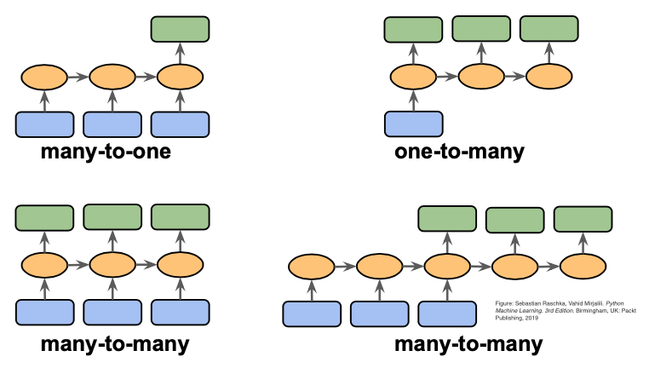
A quick word on one/many-to-one/many models

Slide 5
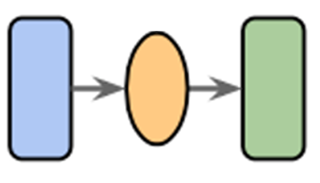
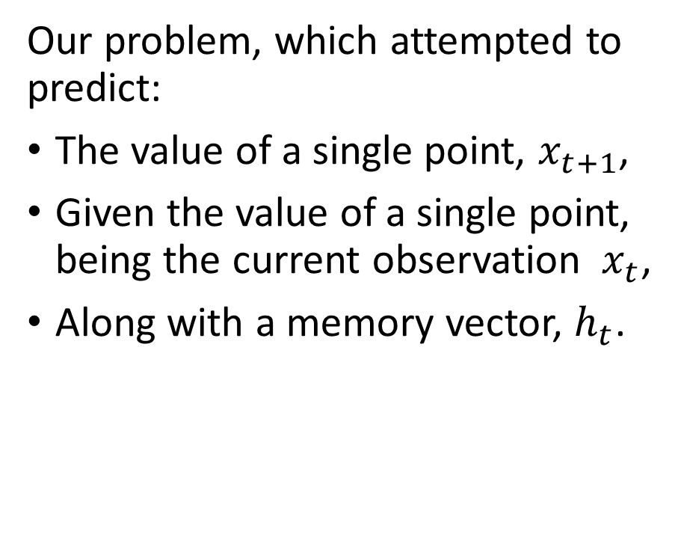
One-to-one models
Definition (one-to-one models):
A one-to-one model is a machine learning model that:
Takes a single input,
And, optionally, a memory vector,
And attempts to produce a single output.
This can be seen as the simplest type of machine learning problem.
Our problem, which attempted to predict:
The value of a single point, $x_{t+1}$,
Given the value of a single point, being the current observation $x_{t}$,
Along with a memory vector, $h_{t}$.

Slide 6
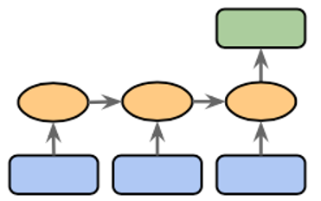
Many-to-one models
Definition (many-to-one models):
A many-to-one model is a machine learning model that:
Takes many inputs (in sequence or not),
And, optionally, a memory vector,
And attempts to produce a single output.
This is another common type of ML problem we have seen so far.

Slide 7
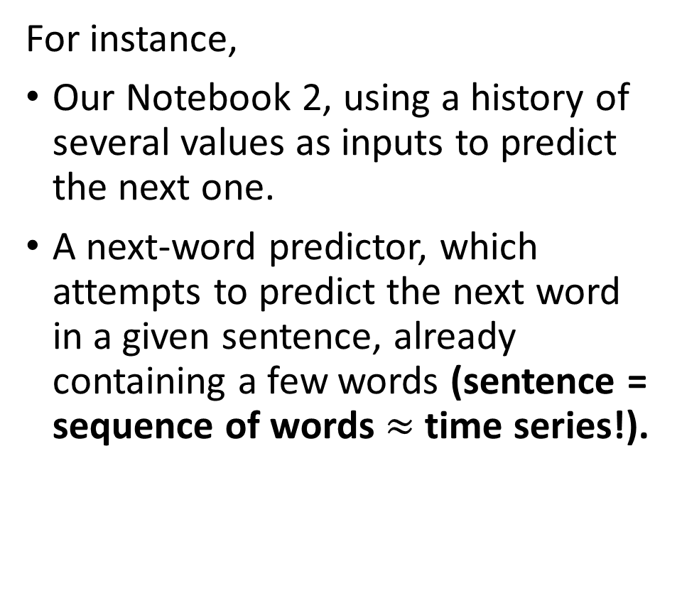
Many-to-one models
Definition (many-to-one models):
A many-to-one model is a machine learning model that:
Takes many inputs (in sequence or not),
And, optionally, a memory vector,
And attempts to produce a single output.
This is another common type of ML problem we have seen so far.
For instance,
Our Notebook 2, using a history of several values as inputs to predict the next one.
A next-word predictor, which attempts to predict the next word in a given sentence, already containing a few words (sentence = sequence of words $≈$ time series!).

Slide 8
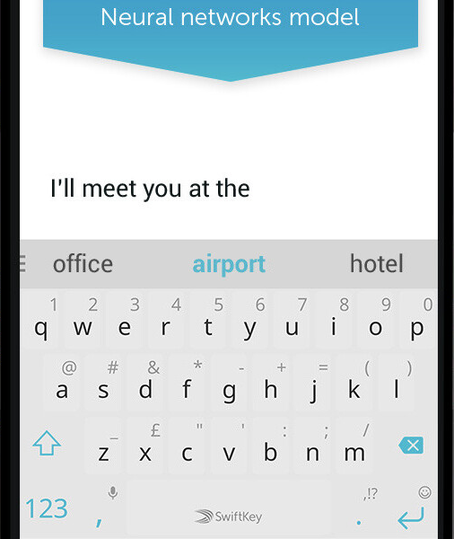
Many-to-one models
Definition (many-to-one models):
A many-to-one model is a machine learning model that:
Takes many inputs (in sequence or not),
And, optionally, a memory vector,
And attempts to produce a single output.
This is another common type of ML problem we have seen so far.

Slide 9
Many-to-one models
Definition (many-to-one models):
A many-to-one model is a machine learning model that:
Takes many inputs (in sequence or not),
And, optionally, a memory vector,
And attempts to produce a single output.
This is another common type of ML problem we have seen so far.
It would be possible to use a RNN of some sort for these problems, and only keep the final output (discarding all other calculated in the process), to compute a loss function of some sort.

Slide 10
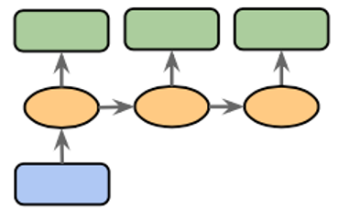
One-to-many models
Definition (one-to-many models):
A one-to-many model is…
You get what it means now.
To be honest, very few problems fall in the category of one-to-many problems, because most of the time we prefer to have a higher dimensionality on inputs rather than the outputs (Note that this might change later!)

Slide 11
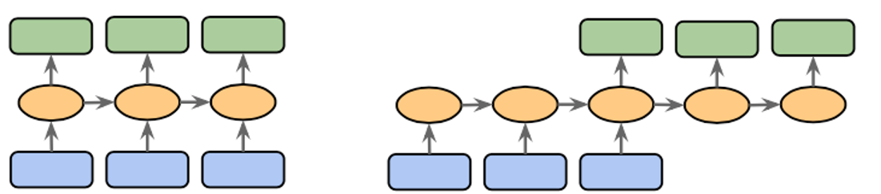
Many-to-many/Sequence-to-sequence models
Definition (many-to-many models):
A many-to-many model is a machine learning model that:
Takes many inputs (in sequence or not),
And, optionally, a memory vector,
And attempts to produce many outputs.
This is also a very common type of ML problems, which we will investigate more on the coming weeks.

Slide 12
Many-to-many/Sequence-to-sequence models
Definition (many-to-many models):
A many-to-many model is a machine learning model that:
Takes many inputs (in sequence or not),
And, optionally, a memory vector,
And attempts to produce many outputs.
This is also a very common type of ML problems, which we will investigate more on the coming weeks.
For instance,
A stock market predictor that takes several points as inputs (history) and attempts to predict the next few values of the stock prices instead of just the next one.
A translation model that translates text from English to French.

Slide 13
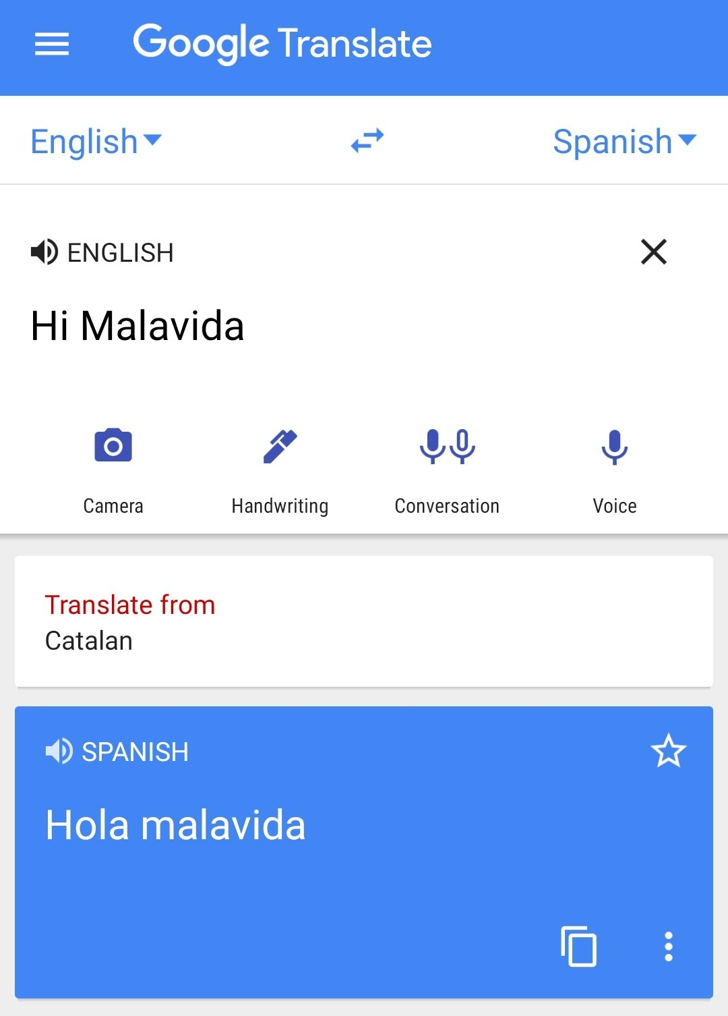
Many-to-many/Sequence-to-sequence models
Definition (many-to-many models):
A many-to-many model is a machine learning model that:
Takes many inputs (in sequence or not),
And, optionally, a memory vector,
And attempts to produce many outputs.
This is also a very common type of ML problems, which we will investigate more on the coming weeks.

Slide 14
Many-to-many/Sequence-to-sequence models
→ But then, what is the difference between these two diagrams?

Slide 15
Encoder and Decoder models
Definition (Seq2Seq, encoder and decoder models):
A Seq2Seq model is a special type of many-to-many model. Its key difference relies in separating the analysis of the input sequence and the production of an output after having seen all inputs.
This is often handled by two differents part of a larger neural network, called an encoder and a decoder network.

Slide 16
Encoder and Decoder models
Definition (Seq2Seq, encoder and decoder models):
In general, the first part of a Seq2Seq model will focus on analysing the input sequence, eventually producing a final memory vector output after having seen all inputs. This is called an encoder.
Can be done with a RNN of some sort, where the final memory state is called the encoding vector.
E.g. read an English sentence, progressively encoding each word’s meaning, to obtain the entire sentence meaning in a single encoding vector.

Slide 17
Encoder and Decoder models
Definition (Seq2Seq, encoder and decoder models):
In general, the second part of the model will focus on analysing the produced encoding vector and producing a sequence of some sort as output. This is called a decoder.
Can be done with the same (or another) RNN of some sort, where the first memory state consists of the encoding vector.
E.g. read an encoding vector describing an English sentence and produce an output sequence being the French translation.

Slide 18
Encoder and Decoder models
Encoder model: can be seen as a many-to-one model of some sort, receiving a sequence as input and producing a single encoding vector as output.
Decoder model: does the opposite (kind of), that is receiving this single encoding vector as input and producing a sequence as output.

Slide 19
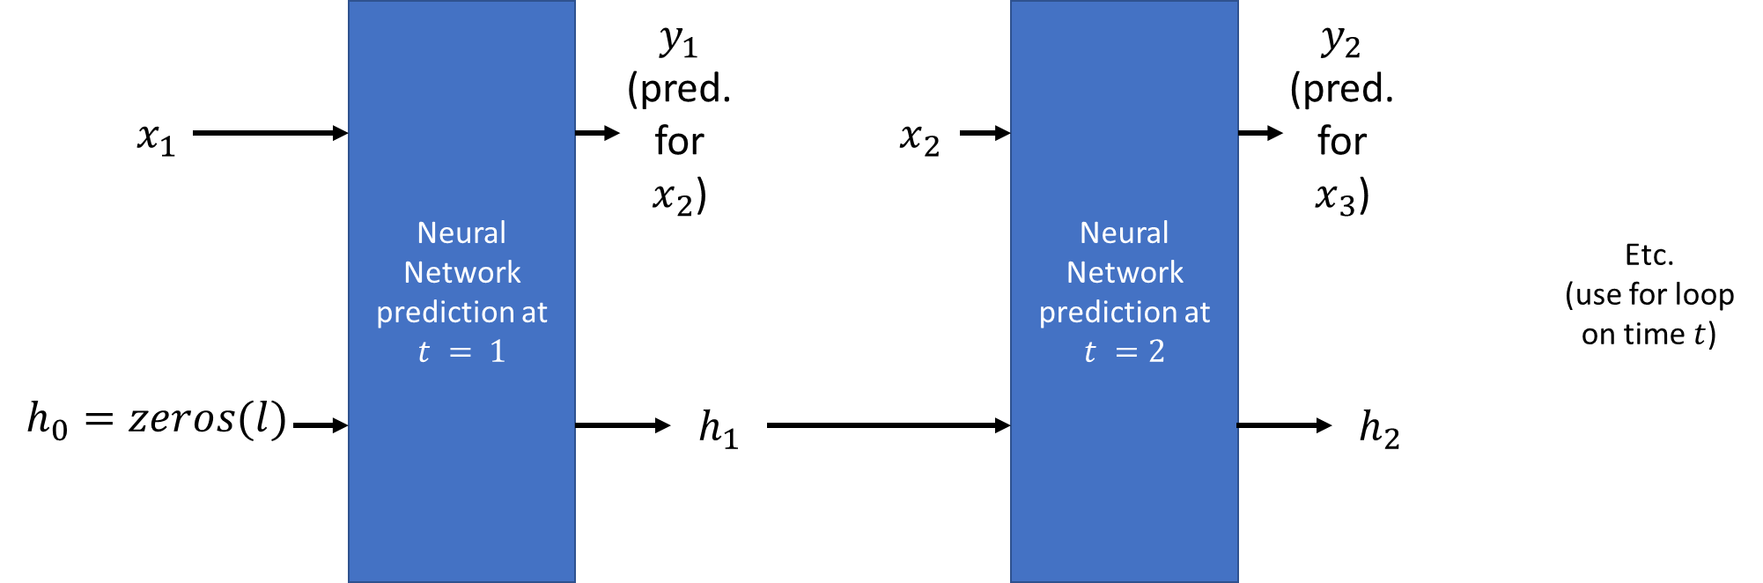

A quick word on autoregressive RNNs
Our previous RNN models looked like this: start with an empty memory vector $h_{0}$, predict $y_{t}$ and update memory vector $h_{t}$using a new observation $x_{t}$ as input on each time step.

Slide 20

A quick word on autoregressive RNNs
Important: our RNNs models would not be using our prediction $y_{t}$ as the new observation for the next step $x_{t+1}$!

Slide 21
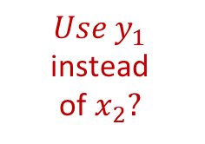
A quick word on autoregressive RNNs
But what if we did?
$$Use y_{1}$$
instead of$x_{2}?$

Slide 22
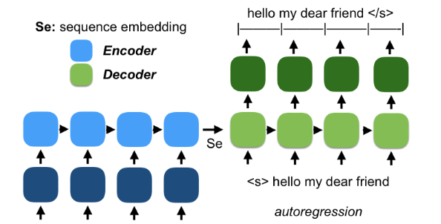
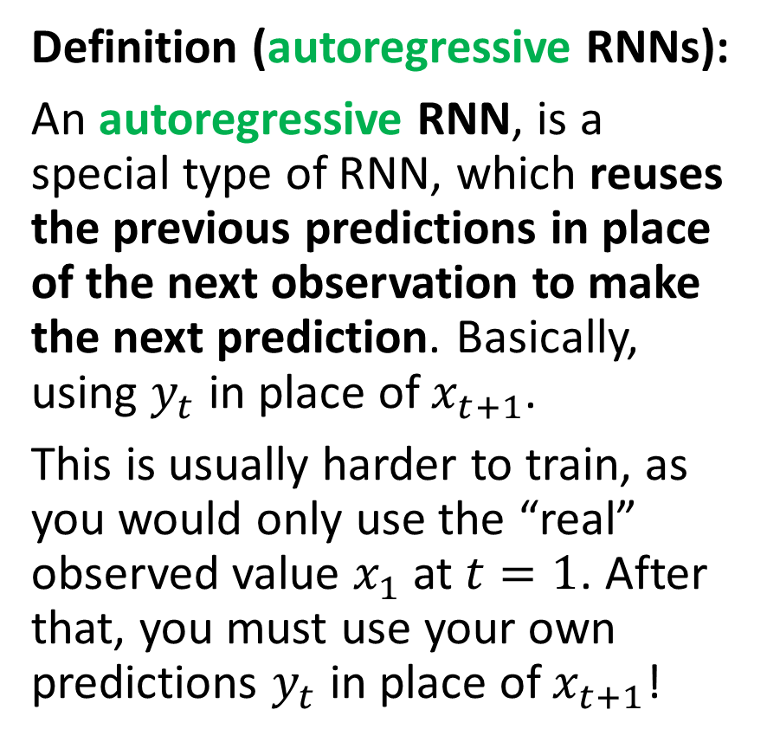
A quick word on autoregressive RNNs
Definition (autoregressive RNNs):
An autoregressive RNN, is a special type of RNN, which reuses the previous predictions in place of the next observation to make the next prediction. Basically, using $y_{t}$ in place of $x_{t+1}$.
This is usually harder to train, as you would only use the “real” observed value $x_{1}$ at $t=1$. After that, you must use your own predictions $y_{t}$ in place of $x_{t+1}$!
Bonjour Mon Cher Ami

Slide 23
A quick word on autoregressive RNNs
Typically, we love to use these autoregressive models in Natural Language Processing, for instance when it comes to generating output sequences.
E.g. generate an English sentence for a given encoding vector describing the meaning of a French sentence.
Bonjour Mon Cher Ami

Slide 24
A quick word on autoregressive RNNs
Encoder reads the French sentence and produces a sequence embedding/encoding vector Se as the final memory vector.
Bonjour Mon Cher Ami

Slide 25
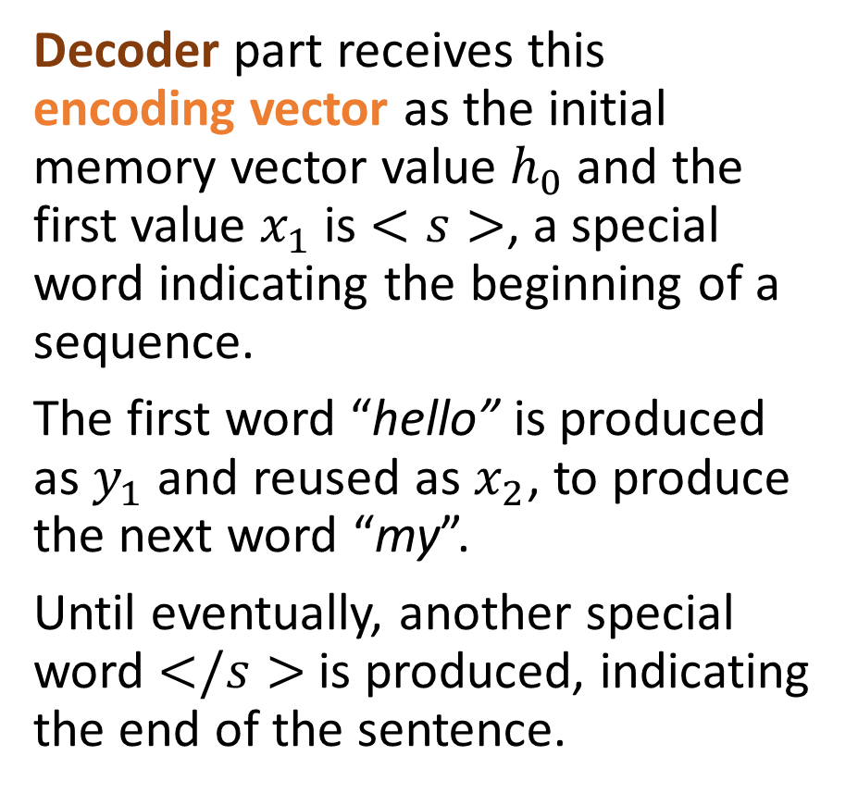
A quick word on autoregressive RNNs
Decoder part receives this encoding vector as the initial memory vector value $h_{0}$ and the first value $x_{1}$ is $<s>$, a special word indicating the beginning of a sequence.
The first word “hello” is produced as $y_{1}$ and reused as $x_{2}$, to produce the next word “my”.
Until eventually, another special word $</s>$is produced, indicating the end of the sentence.
Bonjour Mon Cher Ami

Slide 26
A quick word on autoregressive RNNs
Typically, ChatGPT is a Seq2Seq model using autoregressive RNNs!
Takes a sequence of words as input (the user question) and encodes it,
And uses a decoder architecture of some sort to reconstructs an answer, a sentence, one word after the other!

Slide 27
A quick word on autoregressive RNNs
Typically, ChatGPT is a Seq2Seq model using autoregressive RNNs!
Takes a sequence of words as input (the user question) and encodes it,
And uses a decoder architecture of some sort to reconstructs an answer, a sentence, one word after the other!

Slide 28
A quick word on autoregressive RNNs
Typically, ChatGPT is a Seq2Seq model using autoregressive RNNs!
Takes a sequence of words as input (the user question) and encodes it,
And uses a decoder architecture of some sort to reconstructs an answer, a sentence, one word after the other!
We will learn more about these autoregressive models during Weeks 8 (Introduction to NLP) and 13 (ChatGPT)!
And during the NLP specialty course on Term 7!

Slide 29
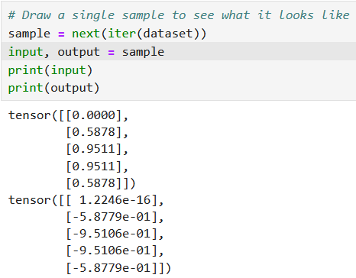
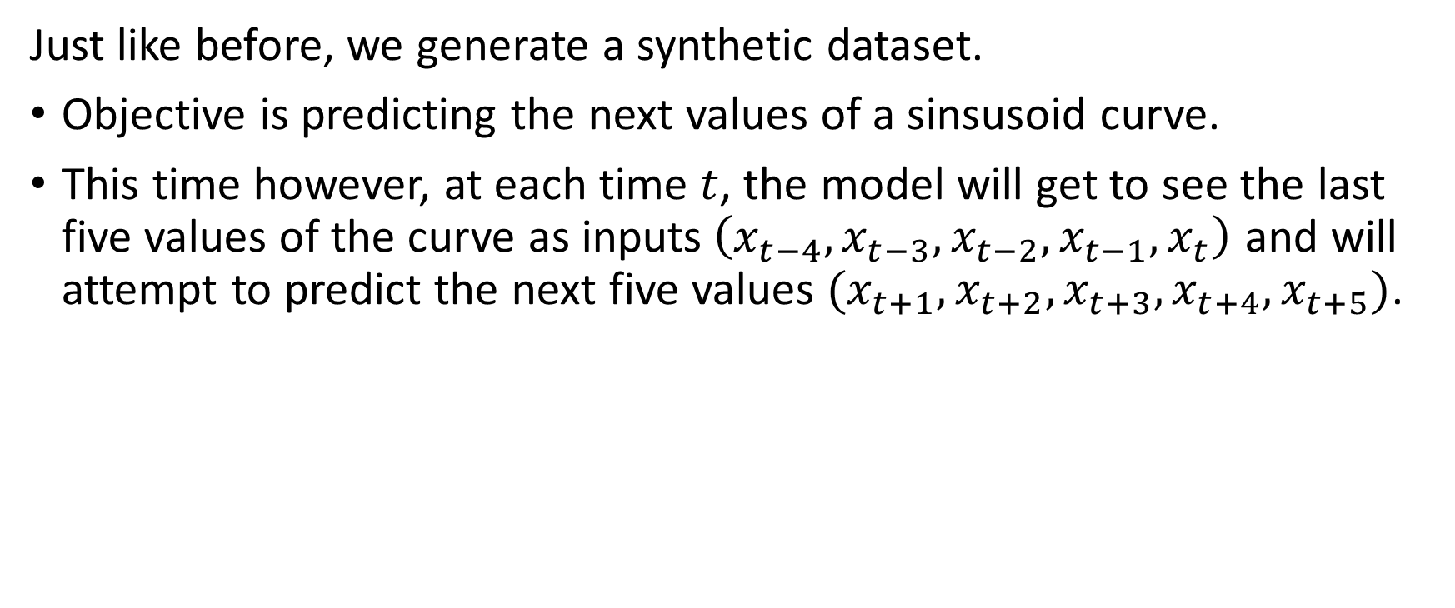
Implementation of a simple Seq2Seq
Just like before, we generate a synthetic dataset.
Objective is predicting the next values of a sinsusoid curve.
This time however, at each time $t$, the model will get to see the last five values of the curve as inputs$\left(x_{t−4}, x_{t−3}, x_{t−2}, x_{t−1}, x_{t}\right)$ and will attempt to predict the next five values $(x_{t+1}, x_{t+2}, x_{t+3}, x_{t+4}, x_{t+5})$.

Slide 30
Implementation of a simple Seq2Seq
Just like before, we generate a synthetic dataset.
Objective is predicting the next values of a sinsusoid curve.
This time however, at each time $t$, the model will get to see the last five values of the curve as inputs$\left(x_{t−4}, x_{t−3}, x_{t−2}, x_{t−1}, x_{t}\right)$ and will attempt to predict the next five values $(x_{t+1}, x_{t+2}, x_{t+3}, x_{t+4}, x_{t+5})$.

Slide 31
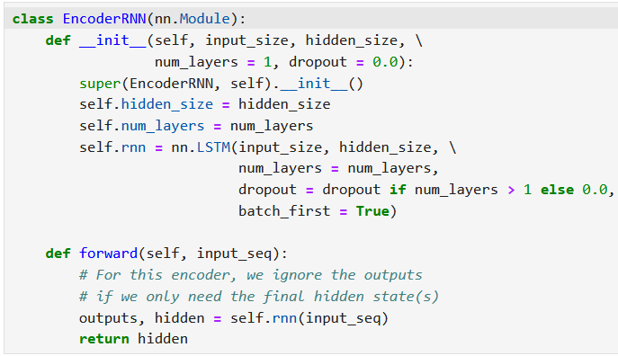
Our Encoder RNN
The EncoderRNN shown in Notebook 6 and 7 processes input sequences through several layers of LSTM.
It uses several layers of LSTM and possibly dropout.
It is designed to capture the temporal dependencies in the data and encode this input in an encoding vector.

Slide 32
Our Encoder RNN
Only the final hidden states are returned, encapsulating the learned representation of the entire sequence as an encoding vector.
This encoder will later be used in a sequence-to-sequence model, where its final hidden state initializes the decoder to generate outputs based on the input sequence.

Slide 33
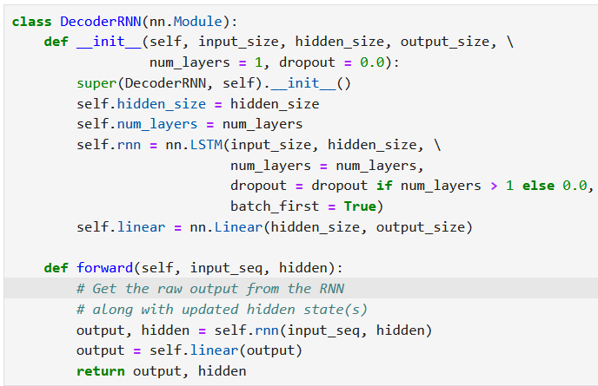
Our Decoder RNN
The DecoderRNN class is designed to act as the decoder in a sequence-to-sequence architecture.
It processes the encoding vector using an LSTM and then maps the LSTM outputs to the desired output space with a single and final linear layer.

Slide 34
Seq2Seq assembling Encoder and Decoder
Assembling our encoder and decoder classes from earlier, the Seq2Seq class implements a sequence-to-sequence model using an encoder-decoder architecture.
The encoder processes the input sequence to produce a final hidden state, which is then used as the starting point for the memory vector of the decoder.
The decoder is then responsible for generating the output sequence.

Slide 35
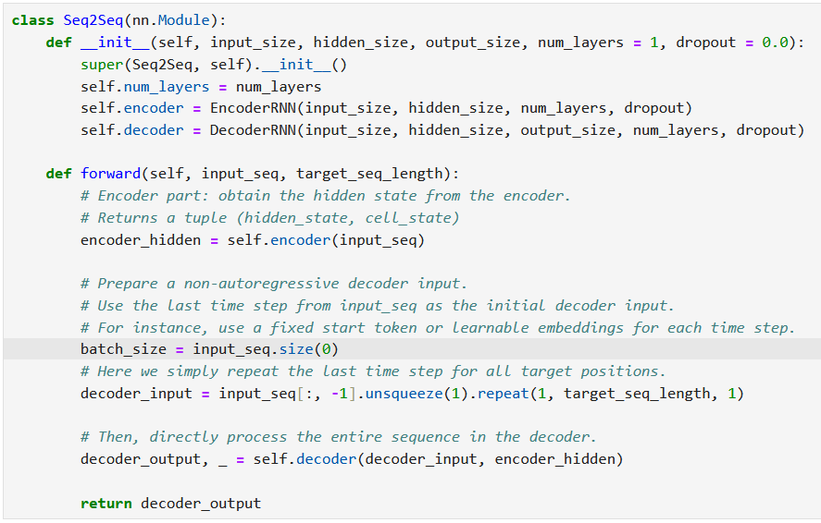
Seq2Seq assembling Encoder and Decoder
Assembling our encoder and decoder classes from earlier, the Seq2Seq class implements a sequence-to-sequence model using an encoder-decoder architecture.
The encoder processes the input sequence to produce a final hidden state, which is then used as the starting point for the memory vector of the decoder.
The decoder is then responsible for generating the output sequence.

Slide 36
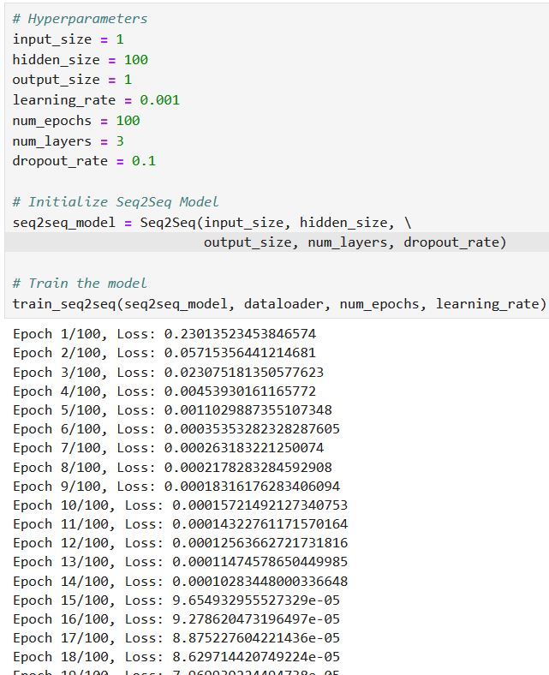
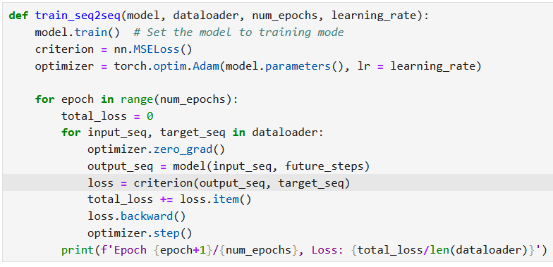
Trainer is kept simple
And it trains nicely!

Slide 37
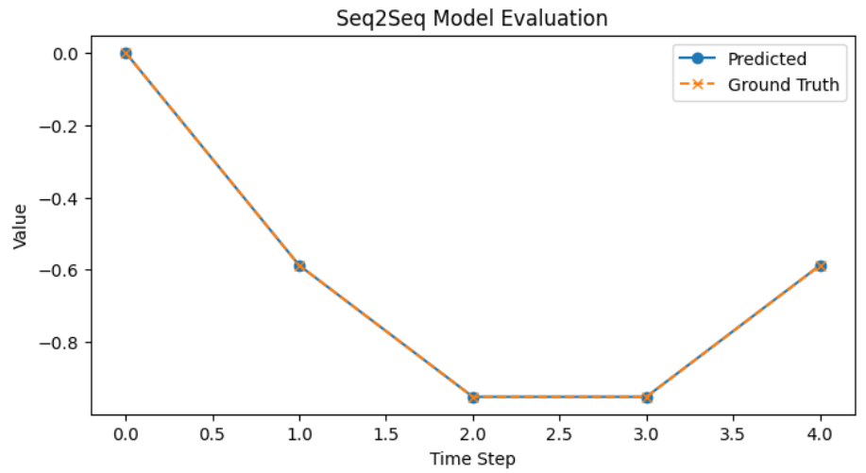
Trainer is kept simple
And it trains nicely!
Confirm training by sampling and testing predictions!

Slide 38
Making it autoregressive
In this first implementation of a Seq2Seq (Notebook 6), we tried to generate the whole output sequence in one go.
Start: The decoder input is prepared by taking the last time step of the encoder’s input and then simply repeating it for every time step you want to predict.
Parallel Processing: The decoder then processes this entire repeated input in one pass, generating all the outputs at once.
Result: All parts of the output sequence are generated simultaneously, without depending on previous outputs.

Slide 39
Making it autoregressive
If we want to make it an autoregressive RNN (which is shown in Notebook 7), a few changes need to occur:
Start: The decoder begins with a starting input (taken from the last time step of the encoder’s input), as before.
Loop: For each time step, the decoder produces a single output of the sequence. Using a loop, that output is then fed back as the input to be used by the decoder to generate the next output of the sequence for the next time step.
Result: The final output sequence is built one element at a time, with each prediction depending on the one before it.

Slide 40
Making it autoregressive
If we want to make it an autoregressive RNN (which is shown in Notebook 7), a few changes need to occur:
Start: The decoder begins with a starting input (taken from the last time step of the encoder’s input), as before.
Loop: For each time step, the decoder produces a single output of the sequence. Using a loop, that output is then fed back as the input to be used by the decoder to generate the next output of the sequence for the next time step.
Result: The final output sequence is built one element at a time, with each prediction depending on the one before it.

Slide 41
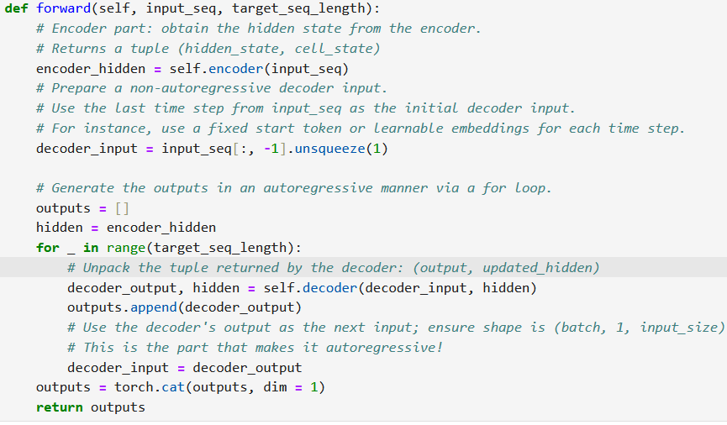
Making it autoregressive
This requires a minimal adjustment in the forward method of the Seq2Seq model to make the magic happen.

Slide 42
Go autoregressive or not?
Why Choose an Autoregressive Model?
Sequential Dependency: Autoregressive models generate output one step at a time, with each new prediction influenced by the previous ones. This is especially beneficial when the sequence elements have strong dependencies—such as in natural language (Week 8!), where each word affects the next.
High Accuracy in Complex Tasks: Because each output can be conditioned on the previously generated outputs, autoregressive models tend to produce more coherent and contextually appropriate results. This is why they're often used in tasks like machine translation, language modeling, and text generation.
Flexibility with Variable-Length Output: Since the model generates output sequentially, it can easily adapt to generating sequences of different lengths, stopping when a special end-of-sequence token is produced.

Slide 43
Go autoregressive or not?
Why not use an autoregressive model?
Reduced Inference Time and Efficient Batch Prediction: In time series forecasting, non-autoregressive models predict future values directly from a fixed window of observed historical data. This contrasts with autoregressive models, which recursively feed each prediction back into the model to generate the next step. By removing the recursive dependency on previous predictions, non-autoregressive models can compute all future values in parallel (at least during training and one-step-ahead prediction), or efficiently process entire sequences in batches, leading to faster inference. This makes non-autoregressive approaches particularly attractive for batch forecasting in operational systems where large numbers of time series need to be processed simultaneously.

Slide 44
Go autoregressive or not?
Why not use an autoregressive model?
Simpler Training for Certain Tasks: For tasks where the outputs do not depend heavily on each other or where dependencies can be modelled in another way, non-autoregressive approaches may simply work better than autoregressive ones.

Slide 45
Go autoregressive or not?
In Summary…
Autoregressive models are preferred when capturing the sequential nature of data is crucial, providing higher accuracy and more coherent outputs at the cost of slower, step-by-step generation. They are usually harder to train but exhibit better performance.
Non-autoregressive models are ideal when speed and parallel processing are critical, even though they might sacrifice some accuracy or contextual coherence since each output is generated independently.
As in all things until now, try and see what works best for your project!

Slide 46
Conclusion (Week 5)
Time series datasets
Deep learning models with history
History length tradeoffs
Implementing memory in Deep Learning models
Our first vanilla Recurrent Neural Network with memory
The vanishing gradient problem in RNNs
The LSTM model
The GRU model
One/Many-to-one/many models
Seq2Seq models
Encoder and Decoder architectures
Autoregressive RNNs
(More on these during W8!)

Slide 47
Learn more about these topics
Out of class, supporting papers, for those of you who are curious.
[Hochreiter1997] S. Hochreiter and J. Schmidhuber “Long short-term memory”, 1997.
[Gers2013] F. A. Gers, J. Schmidhuber, F. Cummin, “Learning to forget: Continual prediction with LSTM”, 2013.
[Cho2014] K. Cho, B. van Merrienboer, C. Gulcehre, D. Bahdanau, F. Bougares, H. Schwenk, and Y. Bengio, “Learning Phrase Representations using RNN Encoder-Decoder for Statistical Machine Translation”, 2014.

Slide 48
Learn more about these topics
Tracking important names (Track their works and follow them on Scholar, Twitter, or whatever works for you!)
Kyunghyun Cho: Professor at New York University. https://scholar.google.co.uk/citations?user=0RAmmIAAAAAJ&hl=en https://kyunghyuncho.me/
Dzmitry Bahdanau: Research Scientist at Element AI and Adjunct Professor at McGill University. https://scholar.google.de/citations?user=Nq0dVMcAAAAJ&hl=en https://rizar.github.io/

Slide 49
Learn more about these topics
Tracking important names (Track their works and follow them on Scholar, Twitter, or whatever works for you!)
Jürgen Schmidhuber: Professor at the University of Lugano in Switzerland. https://scholar.google.com/citations?user=gLnCTgIAAAAJ&hl=fr https://people.idsia.ch/~juergen/
Sepp Hochreiter: Professor at the Johannes Kepler University of Linz in Austria. https://scholar.google.at/citations?user=tvUH3WMAAAAJ&hl=en https://www.iarai.ac.at/people/sepphochreiter/

Slide 50
Learn more about these topics
Some extra (easy) reading and videos for those of you who are curious.
[LesleyEdu] “How Memories Are Made: Stages of Memory Formation”, explains in simple terms how the human brain processes information and generates memory. https://lesley.edu/article/stages-of-memory
[Medium] “GPT-3, RNNs and All That: A Deep Dive into Language Modelling”, explains how Large Language Models (such as ChatGPT) work using autoregressive RNNs. Note: the transformer part will be covered on Week 8! https://towardsdatascience.com/gpt-3-rnns-and-all-that-deep-dive-into-language-modelling-7f67658ba0d5

